Slide 1
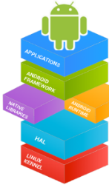

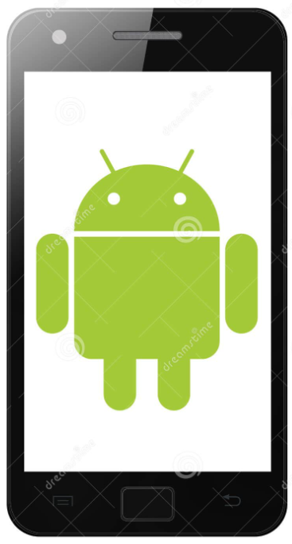

Mobile Application Development (COS7025-B) Designing Mobile Apps using Android Cloud-based Service: Firebase
Karim Hammoud Sadik
Lecture #9
Android Studio

Slide 2
Content
Understood the usefulness of Cloud Computing, and Cloud Databases such as Firebase
Discussed the differences between SQL database and NoSQL database such as Firebase
How to setup NoSQL database such as Firebase from Android Studio

Slide 3
What is Cloud Computing?
1. Cloud computing provides on-demand network access to a shared platform that manages computing resources: Storage, Services, Applications, Servers.
2. A user can interact to the platform globally without any human interaction.
3. Computing resources are assigned and optimized as per the user demand.
Why?
1. Do not require higher specification machine for user.
2. Provides secure data storage.
3. Reduced operation time.
4. Can buy/use resource as require for the services.
Eg: Amazon Web Services, Google Cloud Platform (Firebase), Microsoft Azure, IBM, Oracle, etc.

Slide 4
What is Firebase ?
A Google’s cloud-based app development platform:
Firebase allowed to save data in cloud.
Features:
Cloud Firestore: Serverless store and sync app data at global scale
Cloud Functions: Run mobile backend code without managing servers
Firebase Machine Learning: Machine learning for mobile developers
Authentication: Authenticate user with security
Hosting: Store and serve files.
Realtime Database: Store and synchronise data in real time

Slide 5
What is Firebase ?
Features:
Crashlytics: Realtime crash reporting
Performance Monitoring: Provide app performance platform
Test Lan: Test your app on devices hosted by Google
App Distribution (BETA): Distribute pre-release versions of your app to your trusted users.
Support business analytics such as:
Google Analytics
Predictions
Cloud Messaging
Remote Configuration

Slide 6
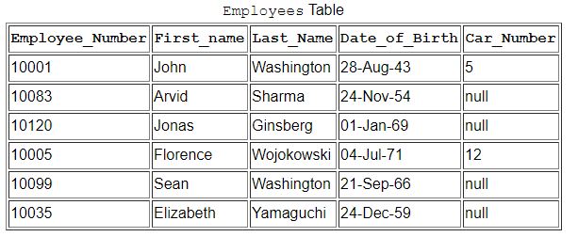
Relational Databases
A relational database stores and provides access to data points that are related to one another.
Based on the relational model, representing data in tables.
Each row in the table is a record with a unique ID called the key.
The columns of the table hold attributes of the data, and each record usually has a value for each attribute, making it easy to establish the relationships among data points.
SQL(MySQL, PostgreSQL, SQLite) is used to read/write data. SQLite is primary data source for android app

Slide 7
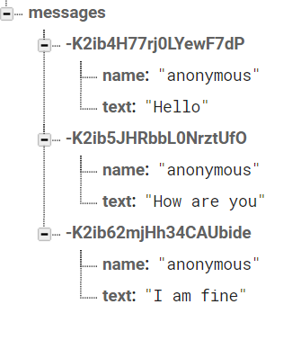
Firebase Realtime Database (NoSQL)
The Firebase Realtime Database is a cloud-hosted database.
Data is stored as JSON and synchronized in realtime to every connected client.
Realtime database helps app users to collaborate by storing and accessing data from different devices.
When an app is built with iOS/Android and JavaScript SDKs, all of users of that app share one Realtime Database instance and automatically receive updates with the newest data.

Slide 8
JSON: Javascript Object Notation
JSON is a lightweight data-interchange format.
It is easy for humans to read and write also easy for machines to parse and generate.
The two primary parts that make up JSON are keys and values. Together they make a key/value pair.
Key: A key is always a string enclosed in quotation marks.
Value: A value can be a string, number, boolean expression, array, or object.
Key/Value Pair: A key value pair follows a specific syntax, with the key followed by a colon followed by the value. Key/value pairs are comma separated.

Slide 9
JSON: Javascript Object Notation
JSON Example
“university” : “UoB”
“university” :{
“name” : “UoB”,
“location”: “Bradford”,
“course”: [“computer”, ”management”]
}
Or,
“university” :{ “name” : “UoB”, “location”: “Bradford”, “course”: [“computer”, ”management”] }

Slide 10
JSON: Javascript Object Notation
JSON Structure: Writing data to firebase
Let’s write some data to firebase database from the firebase console.

Slide 11
Firebase Console
Google has a number of "consoles".
These are webpages to control varying things.
Other Examples:
https://partner.android.com/things/console#/ android things partners
https://console.developers.google.com/apis/ for apis like maps, cloud datastore, cloud sql, cloud storage, etc.
https://developers.google.com/ Dashboard for general google development including Firebase, android, Web, Flutter, YouTube etc.
Firebase has it's own as well.
https://console.firebase.google.com/

Slide 12
Using Firebase Console
You will need to log into the console with google account and setup a project.
It is platform independent. It can be used on iOS, Android, Unity, C++, and on the Web as well.
See the following link for details on how to add Firebase to your Android project
https://firebase.google.com/docs/android/setup#available_libraries

Slide 13
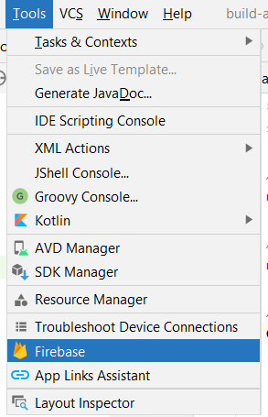
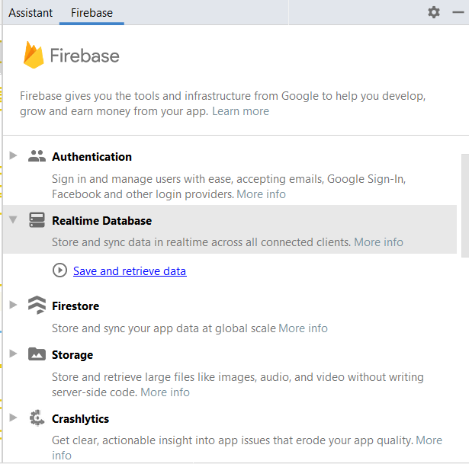
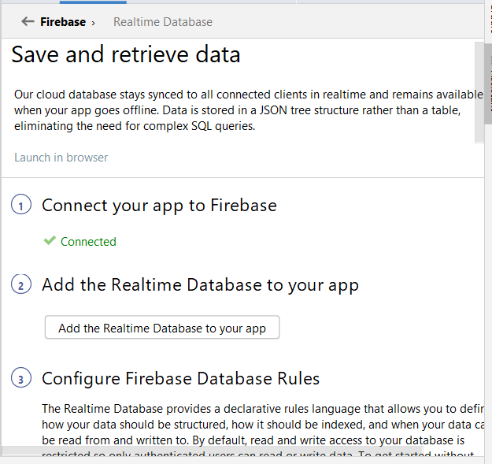
Basic Setup
Setup the Real-time Database: From Android Studio:

Slide 14
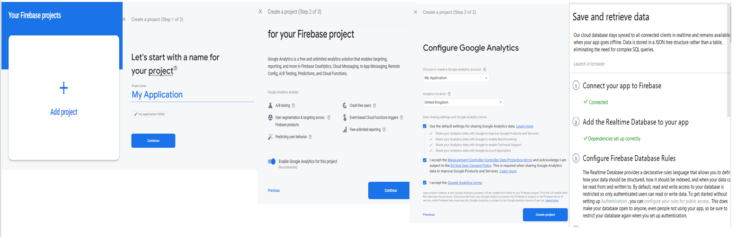
Basic Setup
In the browser: Sing in with your Gmail ID
https://console.firebase.google.com/

Slide 15
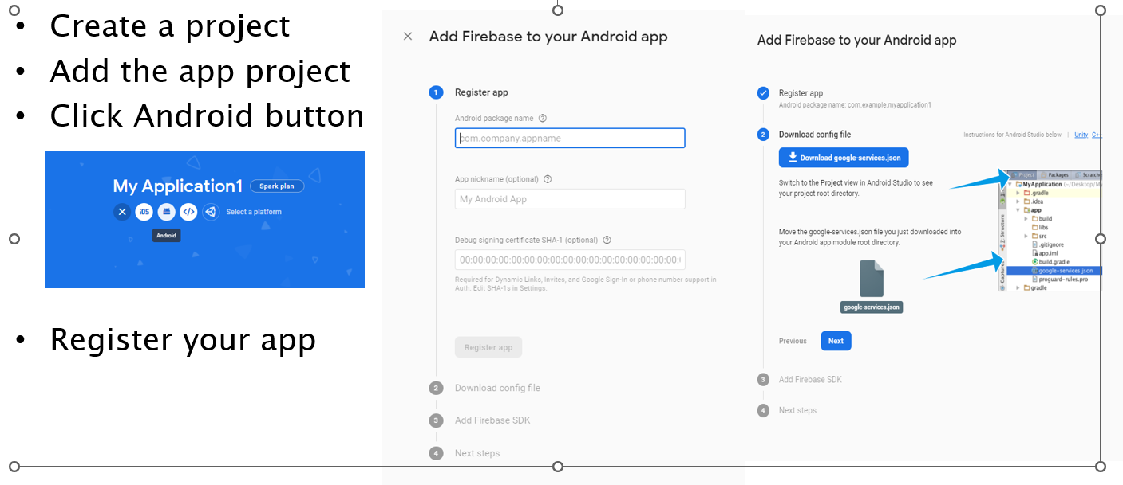
Through the Console only

Slide 16
Writing Data to Firebase Real time Database from app
Instantiate the database in our activity’s code:
FirebaseDatabase firebaseDatabase = FirebaseDatabase.getInstance(“url”);
Get the reference of database’s root/child node to add the data.
DatabaseReference reference = firebaseDatabase.getReference();
DatabaseReference reference1 = firebaseDatabase.getReference().child(“users”);
Set the value using intended child’s key:
reference1.child(“username”).setValue(“Mike”);

Slide 17
Another example: Writing Data to Firebase Realtime Database
mSendButton = (Button) findViewById(R.id.sendButton);
mSendButton.setOnClickListener(new View.OnClickListener() {
@Override
public void onClick(View view) {
FriendlyMessage friendlyMessage = new
FriendlyMessage(mMessageEditText.getText().toString(),
mUsername,
mPhotoUrl,
null /* no image */);
mFirebaseDatabaseReference.child(MESSAGES_CHILD)
.push().setValue(friendlyMessage);
mMessageEditText.setText("");
}
});
Push() method add an automatically generated ID to the pushed object’s path

Slide 18
Reading Data from Firebase Real time Database
Get the reference of database’s root/child node to read the data.
FirebaseDatabase firebaseDatabase = FirebaseDatabase.getInstance(“url”);
DatabaseReference reference = firebaseDatabase.getReference();
Use the reference’s “addValueEventListener” method to listen for changes in the data at a specific location.
reference.addValueEventListener(new ValueEventListener()
{ @override
public void onDataChange(@NonNull DataSnapshot snapshot) {
snapshot.child(“Users”).child(“email”).getValue();
}
@override
public void onCancelled(@NonNull DatabaseError error) {
// throw toast message in case of error
}
});

Slide 19
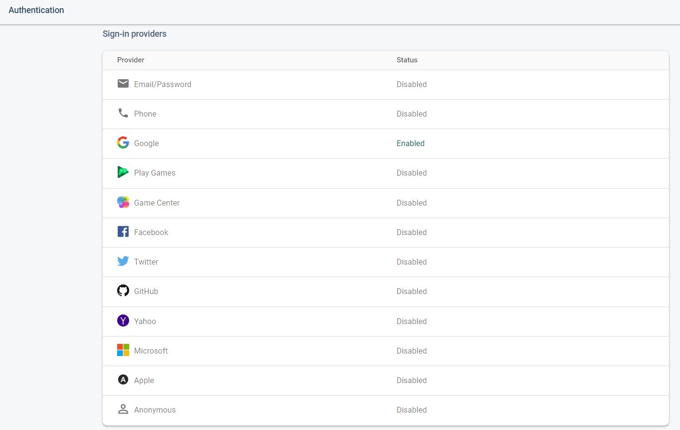
Firebase Authentication
Firebase Authentication build secure authentication for end users.
It provides an end-to-end identity solution, supporting email and password accounts, phone authentication, and Google, Twitter, Facebook, and GitHub login.
Firebase UI provides a customizable, open source, drop-in authentication solution that handles the UI flows for signing in users.

Slide 20
Firebase Authentication
Let’s check the Firebase Authentication on console.
Integration into Android studio like Firebase real time database.
In the java code of your app, you need to instantiate the FirebaseAuth object.
FirebaseAuth auth = FirebaseAuth.getInstance();

Slide 21
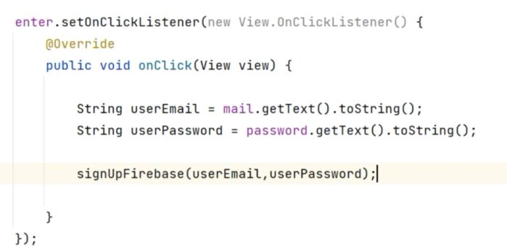
Firebase Authentication
Firebase Authentication (Sign up)

Slide 22
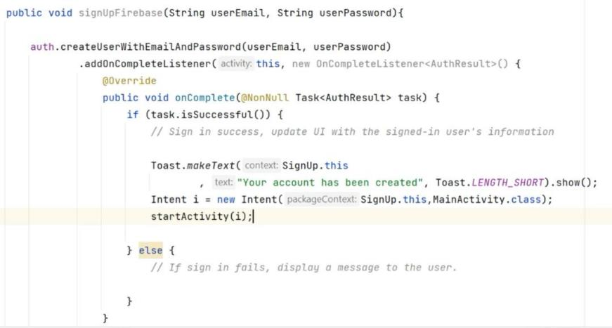
Firebase Authentication
Firebase Authentication (Sign up)

Slide 23
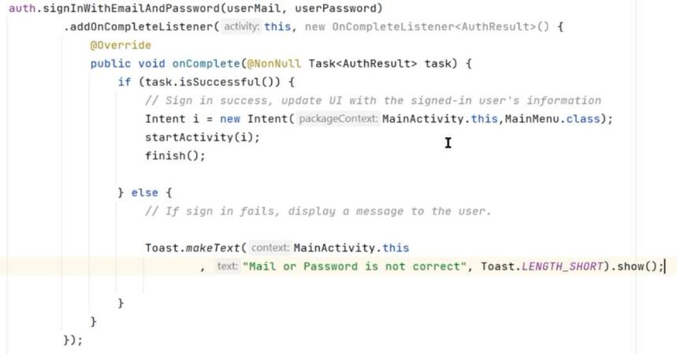
Firebase Authentication
Firebase Authentication (Sign up)

Slide 24
Security Rules
Storage by default doesn't have any security. Need to define rules for the security.
Firebase Security Rules provide robust, completely customizable protection for app data in Cloud Firestore, Realtime Database, and Google Cloud Storage.
Basic rules:
Content-owner only: Restrict access to content by user.
Mixed access: Restrict write access by user, but allow public read access.
Attribute-based access: Restrict access to a group or type of user.
Eg: {
"rules": {
".read": "auth != null",
".write": "auth != null"
}
}
More at https://firebase.google.com/docs/storage/security/get-started

Slide 25
References
https://console.firebase.google.com/
https://firebase.google.com/docs/
Many of the sub doc's where listed on slides.
Code lab: FriendlyChat app
https://codelabs.developers.google.com/codelabs/firebase-android/#0

Slide 26
Any Questions?

